Slide 1
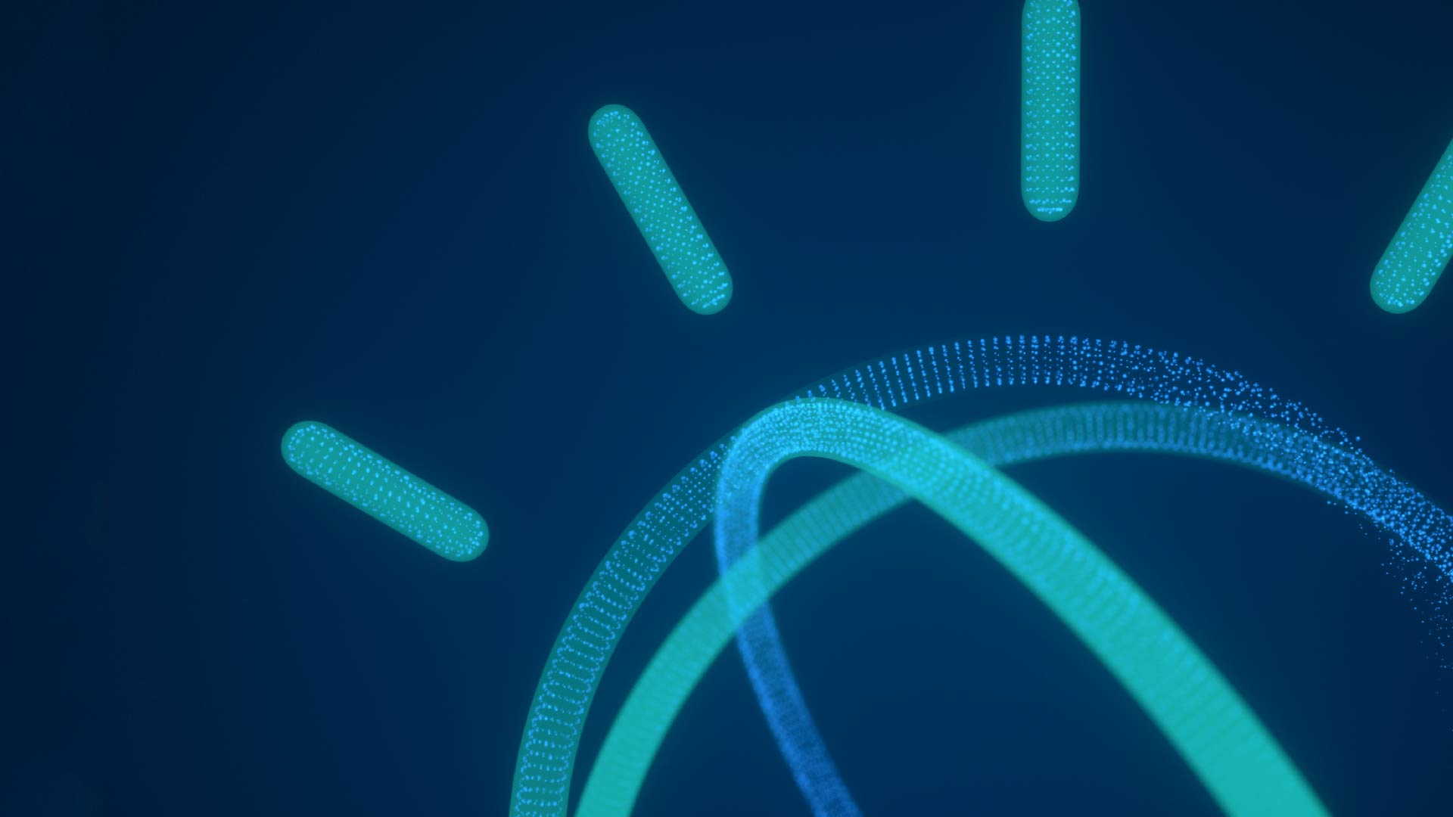
Graph Analysis with Flight Data! Toronto Apache Spark Meetup Matt McInnis November 30th 2016
Big thanks to David Taieb (IBM) for the original analysis!

Slide 2
Objectives
By the end of this session, you should be able to:
Have basic knowledge of Graphs, Graph Databases and associated use cases
Understand Graph processing with Apache Spark GraphX
Use GraphFrames in a Python Notebook to perform basic Graph parallel computation on airports and flights data

Slide 3
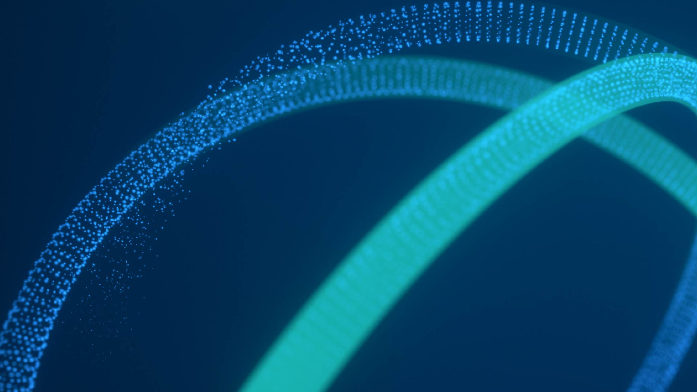
Graphs

Slide 4
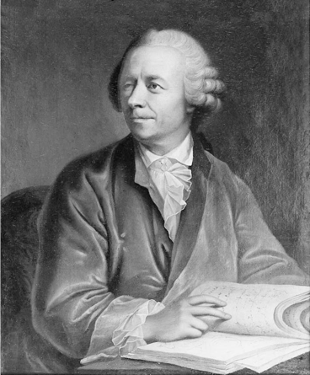
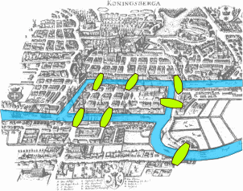
A bit of History
Graph Theory finds its roots from a paper written in 1736 by Leonard Euler on the Seven Bridges of Königsberg urban problem
https://en.wikipedia.org/wiki/Graph_theory
https://en.wikipedia.org/wiki/Seven_Bridges_of_K%C3%B6nigsberg

Slide 5
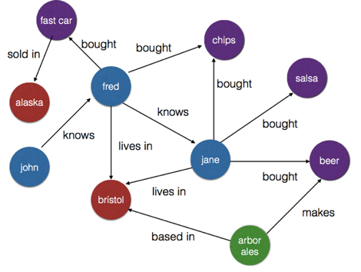
Graphs
A graph is a representation of a set of nodes (vertices) where some pairs of nodes are connected by edges.
Nodes
Edges

Slide 6
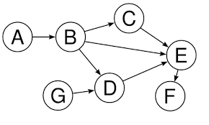
Types of graphs
Directed graphs
A graph where the edges have a direction associated with them. An example of directed graph is a Twitter follower. User Bob can follow user Carol without implying that the reciprocal relationship is true
Regular graphs
Graphs where each vertex has the same number of edges (degree).
Multigraph
Graph where multiple edges with same end nodes are permitted
Acyclic graphs
Graphs which have no cycle
Directed Acyclic Graph

Slide 7
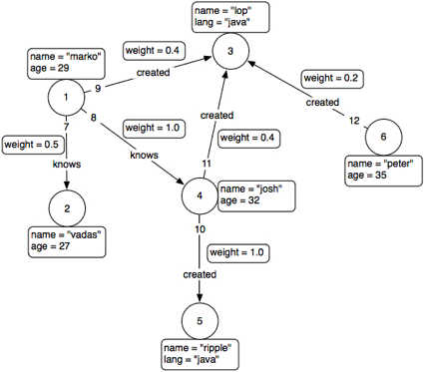
Property Graph
Nodes and edges have properties that can be included in Queries.

Slide 8
Why Graphs?
Graphs are Central to Analytics
Data is not just getting bigger, it’s getting more connected
In many use cases, the relationship between data points provides as much value or more than the data points themselves
Discovering data relationships and interdependencies is critical to many applications
fraud detection
better understanding customer relationships
ranking web pages or people in social networks
Graph analytics is a powerful tool for understanding and exploiting the connections in data
Graph applications are everywhere today

Slide 9
Graph Use cases
Recommendation engines
Anomaly/Fraud Detection
Network Analysis/Route planning
Social Networks
Identity/Access Management
Graph-based search
Master Data Management
Graph is the ‘Natural’ way to represent and query highly connected data

Slide 10



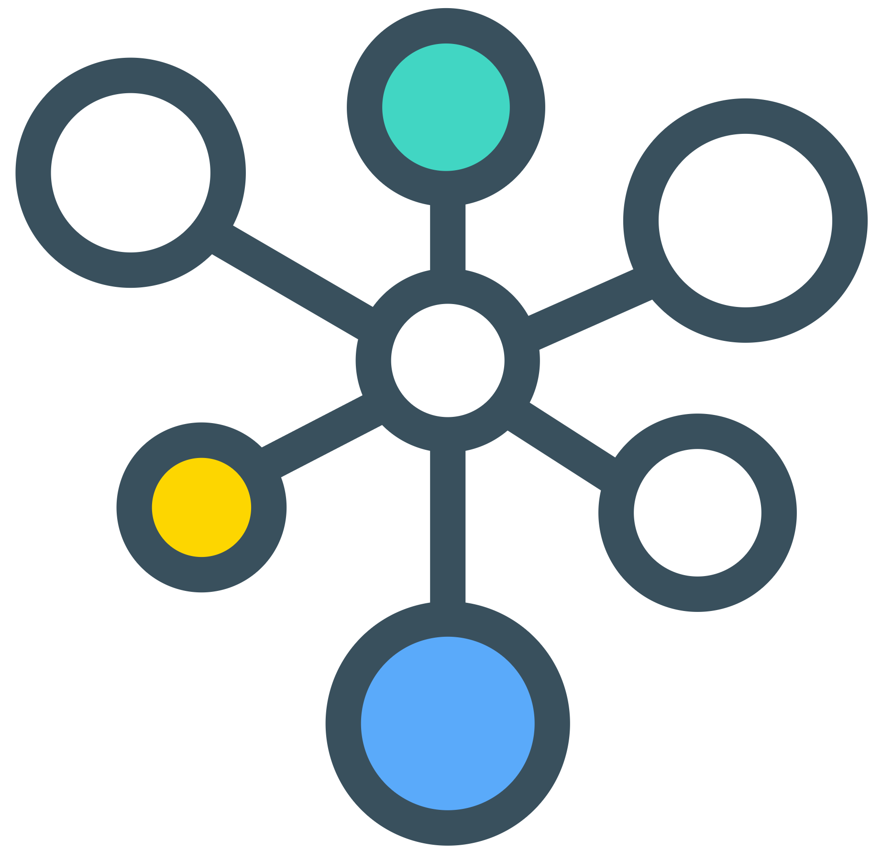


Graph Databases
Provide OLTP (Online Transaction Processing) capabilities.
Focus on optimizing storage and querying of graph data: vertices, edges, and associated metadata
Alternative when complexity of graph data makes classic RDBMS inadequate
Typically work with small sections of the graph
Example Query engines
Gremlin (Tinkerpop)
Motif Findings (Neo4J)
Titan
IBM Graph

Slide 11



Graph processing
Focuses on data analytics (OLAP or Online Analytical processing) on Graphs
Suited when relational databases are inadequate because of the data high dimensionality
Scalability: Distributed Graph-parallel support e.g. BSP (Bulk synchronous processing)
Example building block operations:
Subgraph extractions
Neighborhood aggregation
…
Example algorithms:
BFS: Breadth First Search
PageRank
Collaborative Filtering

Slide 12
Apache Spark GraphX

Slide 13
Spark Core Libraries
executes SQL statements
performs streaming analytics using micro-batches
common machine learning and statistical algorithms
distributed graph processing framework
Spark SQL
Spark Streaming
Mllib
Machine Learning
GraphX
Graph
Spark Core
general compute engine, handles distributed task dispatching, scheduling and basic I/O functions

Slide 14
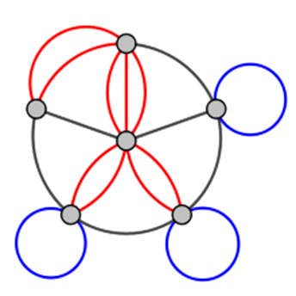
Apache Spark GraphX
Graph Processing System, not a database
Directed multigraph with properties attached to each vertex and edges
Exposes a set of fundamental operators that support graph computation:
Subgraph, joinVertices, aggregateMessages, etc…
Provides algorithms to simplify analytics tasks
PageRank, BFS, Triangle Counting, etc…
Massively parallel: Built on top of Spark RDD

Slide 15
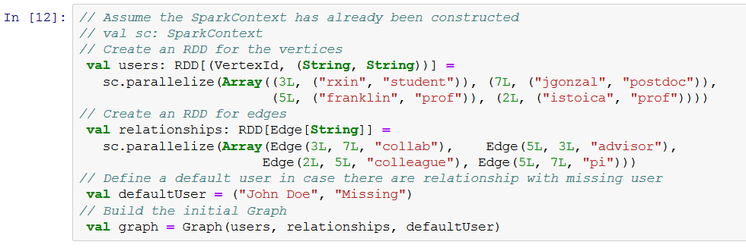
Constructing a property graph with GraphX
Vertices RDD
Edges RDD
Graph = Vertices RDD + Edges RDD

Slide 16
GraphFrames

Slide 17
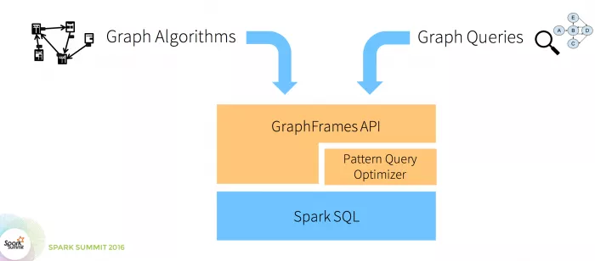
GraphFrames Overview
Add-on component built on top of GraphX: available on spark-packages.org
Addresses main limitations of GraphX:
Python APIs
Uses DataFrames instead of lower-level RDDs: therefore can leverage Catalyst query optimizations
GraphX-GraphFrame conversion
Added Feature:
Motif finding
https://spark-packages.org/package/graphframes/graphframes

Slide 18
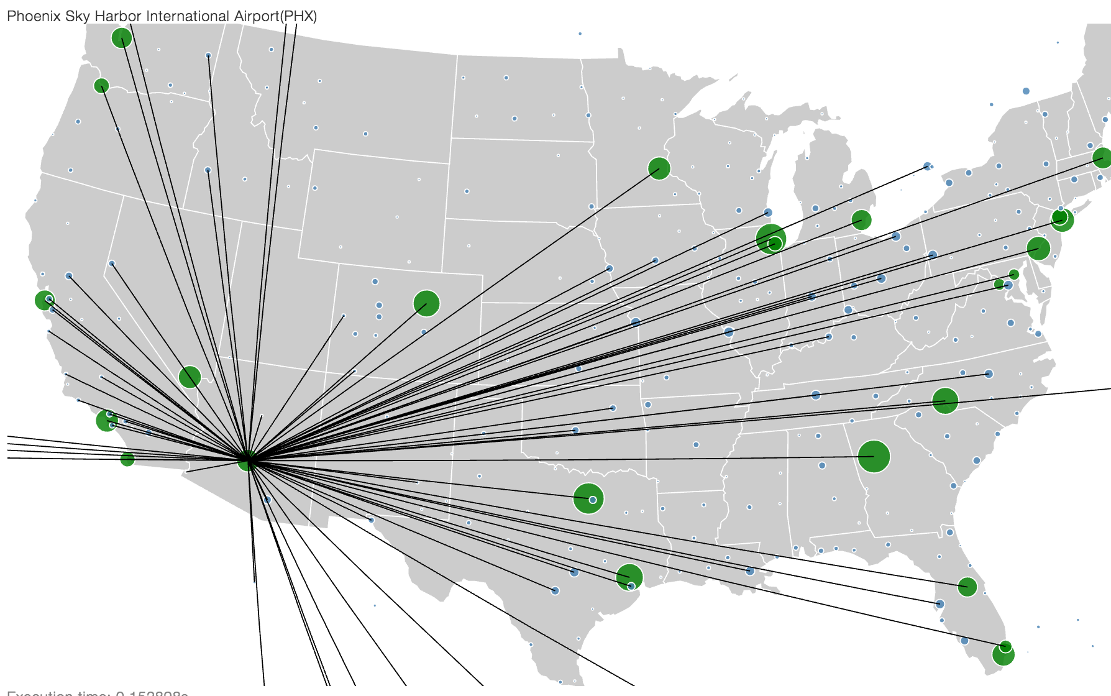
Demo: Create a GraphFrame from airport and flight data
Demo Steps:
Load airport and flight data from Cloudant database
Build the Vertex and Edge DataFrame
Build the GraphFrame
Visualize the graph using PixieDust
Graph computation using the Python APIs
More Graph Computation using the Scala AggregateMessages API and PixieDust Scala bridge

Slide 19
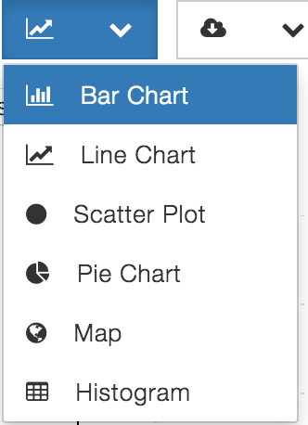
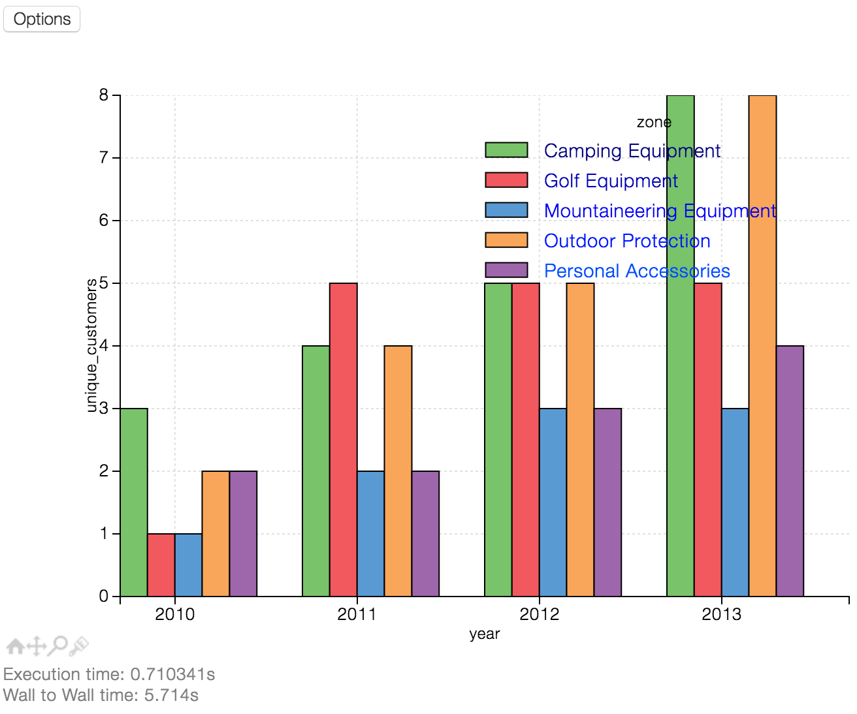
A word about PixieDust
An Open Source Library that simplifies and improves Jupyter Python Notebooks
Jupyter + Pixiedust =
PackageManager
Visualizations
Cloud Integration
Scala Bridge
Extensibility
Embedded Apps
https://github.com/ibm-cds-labs/pixiedust

Slide 20
Do code now!

Slide 21
Resources
Big thanks to David Taieb for the great work building most of this notebook!!
http://spark.apache.org
http://www.ibm.com/analytics/us/en/technology/cloud-data-services/spark-as-a-service
http://datascience.ibm.com
https://developer.ibm.com/clouddataservices/2016/07/15/intro-to-apache-spark-graphframes/
https://developer.ibm.com/clouddataservices/2016/10/11/pixiedust-magic-for-python-notebook/
https://developer.ibm.com/clouddataservices/2016/01/15/real-time-sentiment-analysis-of-twitter-hashtags-with-spark/
https://developer.ibm.com/clouddataservices/2016/08/04/predict-flight-delays-with-apache-spark-mllib-flightstats-and-weather-data/
https://github.com/ibm-cds-labs/spark.samples
https://github.com/ibm-cds-labs/pixiedust
Learn more

Slide 22
Notices and disclaimers
Copyright © 2016 by International Business Machines Corporation (IBM). No part of this document may be reproduced or transmitted in any form without written permission from IBM.
U.S. Government Users Restricted Rights - Use, duplication or disclosure restricted by GSA ADP Schedule Contract with IBM.
Information in these presentations (including information relating to products that have not yet been announced by IBM) has been reviewed for accuracy as of the date of initial publication and could include unintentional technical or typographical errors. IBM shall have no responsibility to update this information. THIS DOCUMENT IS DISTRIBUTED "AS IS" WITHOUT ANY WARRANTY, EITHER EXPRESS OR IMPLIED. IN NO EVENT SHALL IBM BE LIABLE FOR ANY DAMAGE ARISING FROM THE USE OF THIS INFORMATION, INCLUDING BUT NOT LIMITED TO, LOSS OF DATA, BUSINESS INTERRUPTION, LOSS OF PROFIT OR LOSS OF OPPORTUNITY. IBM products and services are warranted according to the terms and conditions of the agreements under which they are provided.
IBM products are manufactured from new parts or new and used parts. In some cases, a product may not be new and may have been previously installed. Regardless, our warranty terms apply.”
Any statements regarding IBM's future direction, intent or product plans are subject to change or withdrawal without notice.
Performance data contained herein was generally obtained in a controlled, isolated environments. Customer examples are presented as illustrations of how those customers have used IBM products and the results they may have achieved. Actual performance, cost, savings or other results in other operating environments may vary.
References in this document to IBM products, programs, or services does not imply that IBM intends to make such products, programs or services available in all countries in which IBM operates or does business.
Workshops, sessions and associated materials may have been prepared by independent session speakers, and do not necessarily reflect the views of IBM. All materials and discussions are provided for informational purposes only, and are neither intended to, nor shall constitute legal or other guidance or advice to any individual participant or their specific situation.
It is the customer’s responsibility to insure its own compliance with legal requirements and to obtain advice of competent legal counsel as to the identification and interpretation of any relevant laws and regulatory requirements that may affect the customer’s business and any actions the customer may need to take to comply with such laws. IBM does not provide legal advice or represent or warrant that its services or products will ensure that the customer is in compliance with any law.

Slide 23
Notices and disclaimers continued
Information concerning non-IBM products was obtained from the suppliers of those products, their published announcements or other publicly available sources. IBM has not tested those products in connection with this publication and cannot confirm the accuracy of performance, compatibility or any other claims related to non-IBM products. Questions on the capabilities of non-IBM products should be addressed to the suppliers of those products. IBM does not warrant the quality of any third-party products, or the ability of any such third-party products to interoperate with IBM’s products. IBM EXPRESSLY DISCLAIMS ALL WARRANTIES, EXPRESSED OR IMPLIED, INCLUDING BUT NOT LIMITED TO, THE IMPLIED WARRANTIES OF MERCHANTABILITY AND FITNESS FOR A PARTICULAR PURPOSE.
The provision of the information contained herein is not intended to, and does not, grant any right or license under any IBM patents, copyrights, trademarks or other intellectual property right.
IBM, the IBM logo, ibm.com, Aspera®, Bluemix, Blueworks Live, CICS, Clearcase, Cognos®, DOORS®, Emptoris®, Enterprise Document Management System™, FASP®, FileNet®, Global Business Services ®, Global Technology Services ®, IBM ExperienceOne™, IBM SmartCloud®, IBM Social Business®, Information on Demand, ILOG, Maximo®, MQIntegrator®, MQSeries®, Netcool®, OMEGAMON, OpenPower, PureAnalytics™, PureApplication®, pureCluster™, PureCoverage®, PureData®, PureExperience®, PureFlex®, pureQuery®, pureScale®, PureSystems®, QRadar®, Rational®, Rhapsody®, Smarter Commerce®, SoDA, SPSS, Sterling Commerce®, StoredIQ, Tealeaf®, Tivoli®, Trusteer®, Unica®, urban{code}®, Watson, WebSphere®, Worklight®, X-Force® and System z® Z/OS, are trademarks of International Business Machines Corporation, registered in many jurisdictions worldwide. Other product and service names might be trademarks of IBM or other companies. A current list of IBM trademarks is available on the Web at "Copyright and trademark information" at: www.ibm.com/legal/copytrade.shtml.

Slide 24
Thank You!

